Slide 1
Azure Search

Slide 2
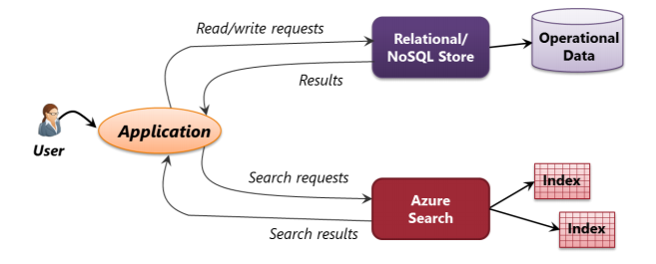
What Azure Search Provides

Slide 3
Search Index – Like table in the RDBMS
Search

Slide 4
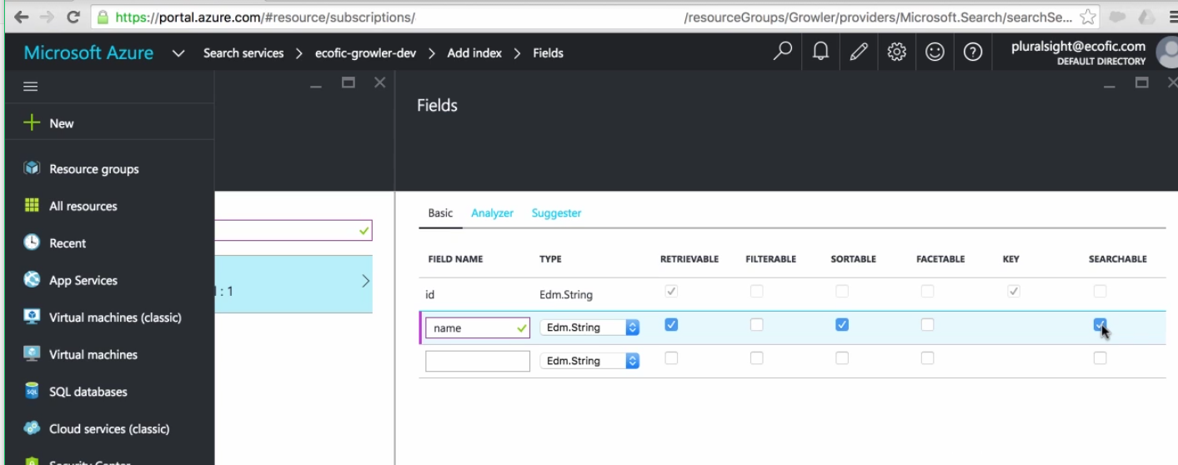
Prabhjot Bakshi in this if you can search for Bakshi als0

Slide 5
Azure search API

Slide 6
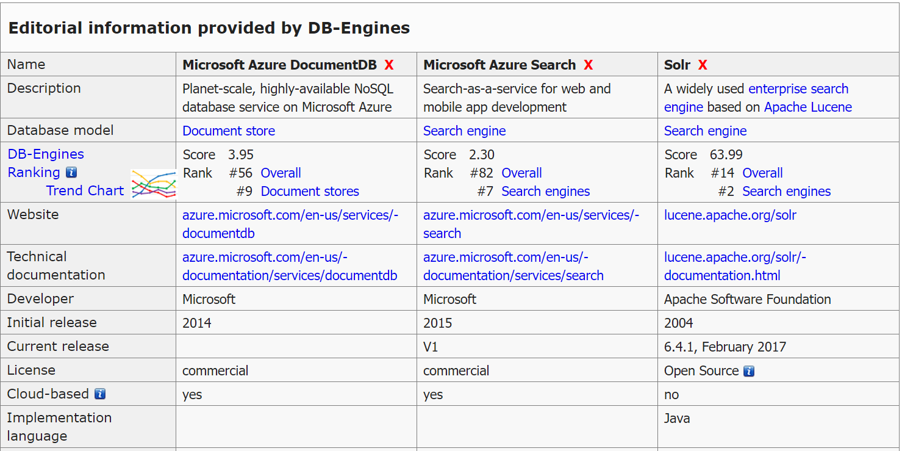

Slide 7
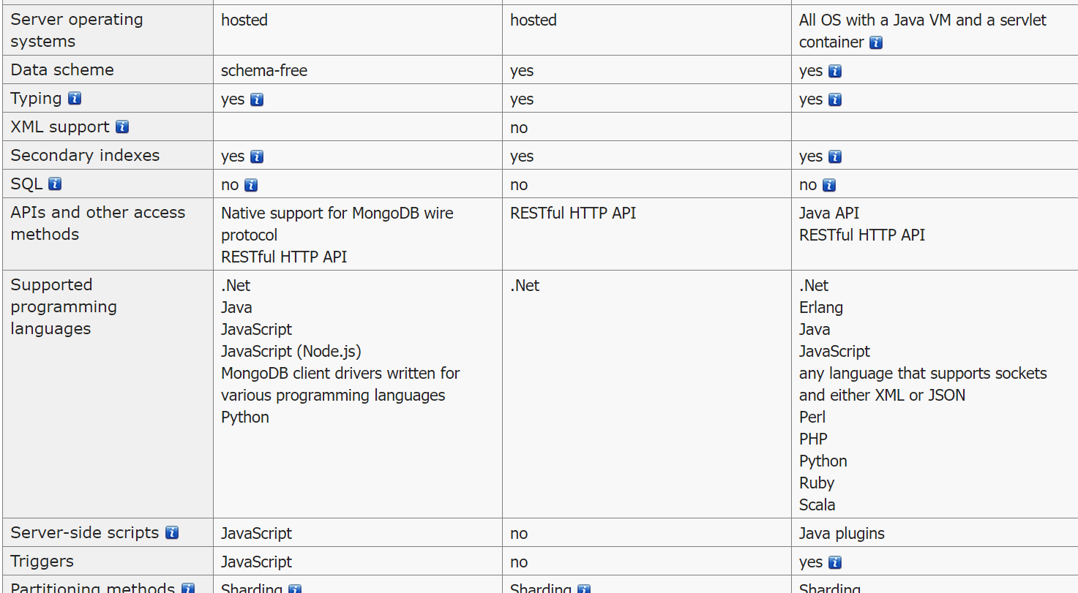

Slide 8
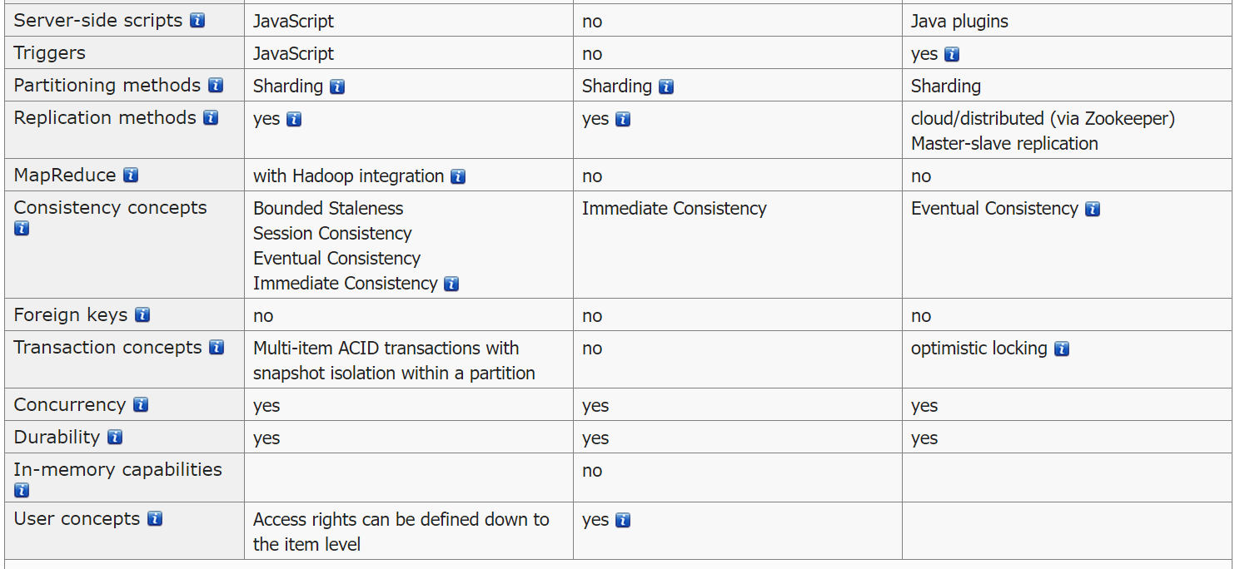

Slide 9
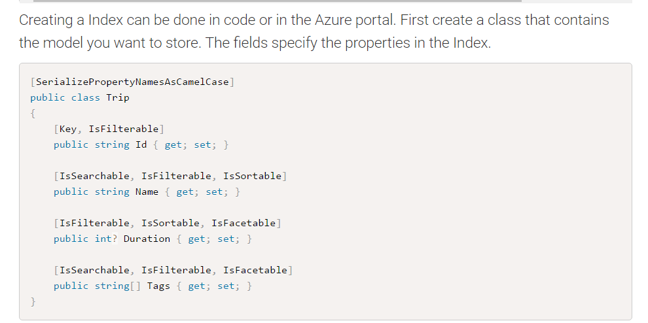
POST https://[servicename].search.windows.net/indexes?api-version=[api-version]
Content-Type: application/json
api-key: [admin key]

Slide 10
